Slide 1
Smart Networks and Services Joint Undertaking Key orientations of SNS JU R&I WP 2024
Javier Albares, Head of Programs
On-line event

Slide 2
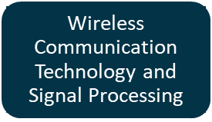
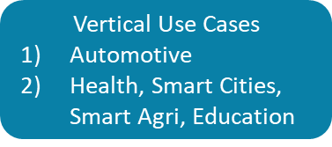
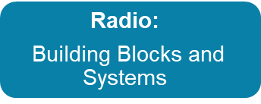
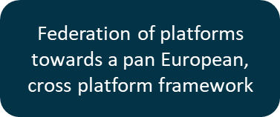
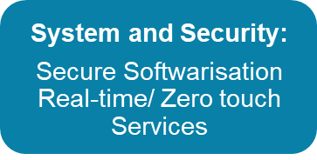
SNS JU Work Programme Structure
Stream A Smart communication components, systems and networks for 5G Evolution systems
Stream B Research for radical technology advancement towards 6G definition
Stream C Experimental infrastructures and Platforms
Stream D Large Scale Trials and Pilots with Verticals
Area of focus 2024 Work Programme

Slide 3
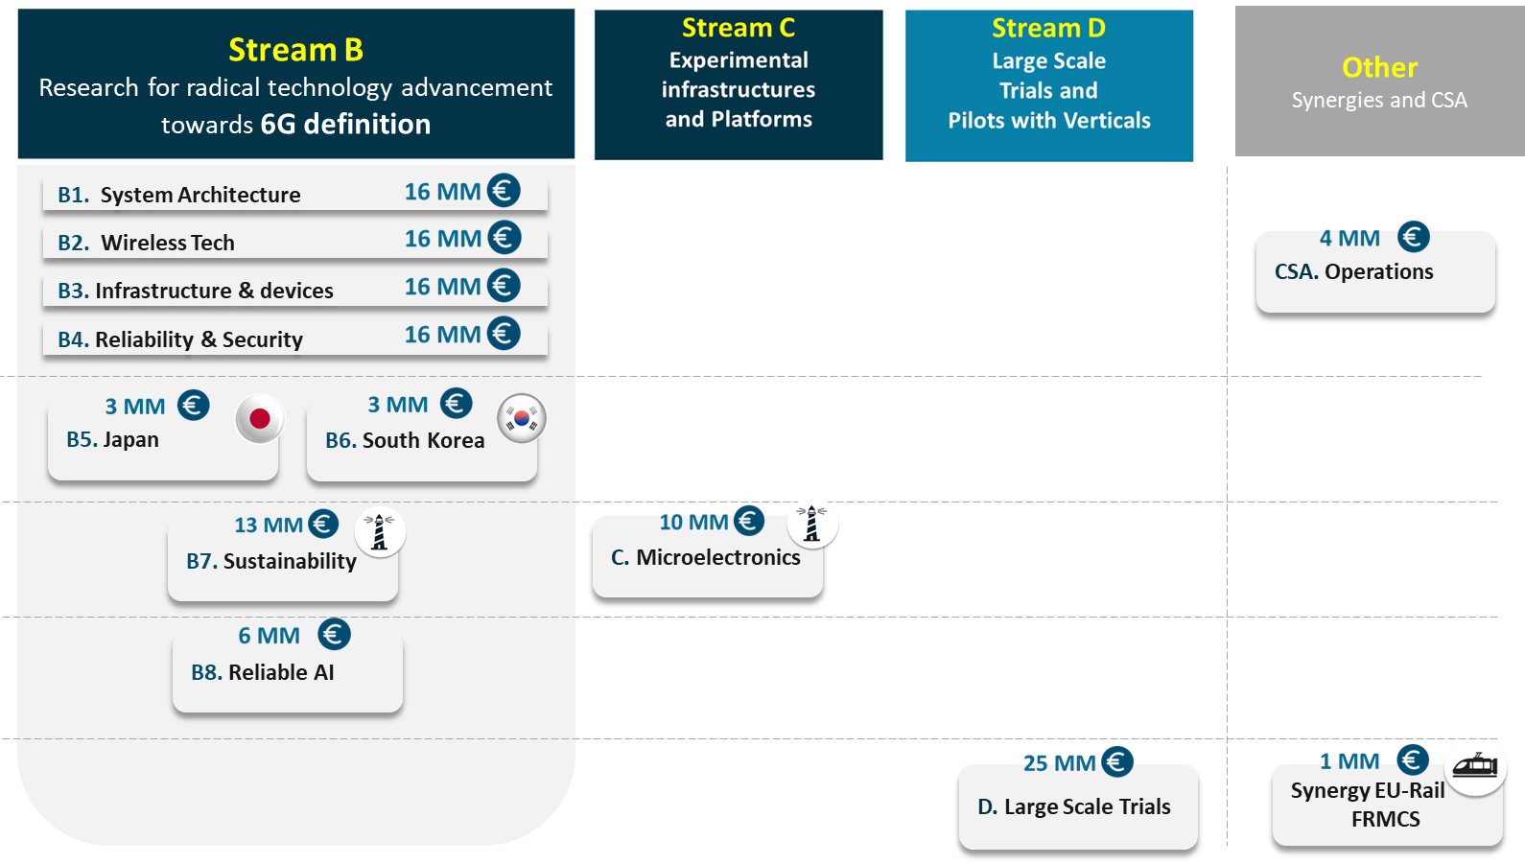
2024 SNS JU Work Program Highlights
SNS 2024
Call 3
129 MM € for
17 Projects
SNS 2024 call 3 conditions based on “General Annexes for Horizon Europe call conditions 2023-2024”

Slide 4
Technology Readiness Levels (TRL)
Stream C
Experimental Infrastructures and Platforms
Stream B
Research for Revolutionary and Evolutionary 6G
Technology
Stream D
Large Scale Trials and Pilots with verticals

Slide 5
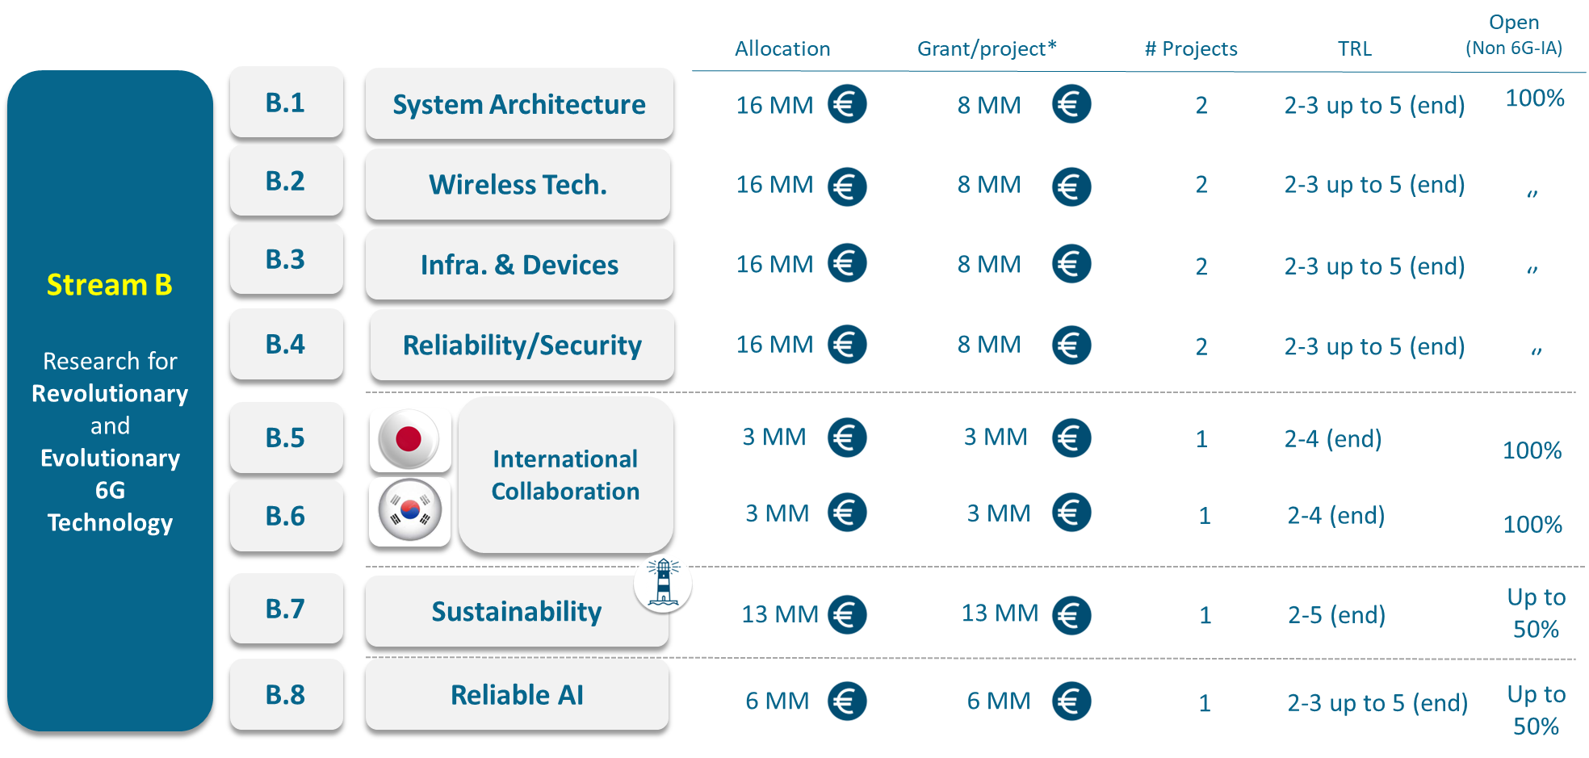
WP 2024/ Stream B
*Indicative; this does not preclude submission and selection of a proposal requesting different amounts.
Notes:
This Stream addresses the industrial, societal and technological long-term challenges related to the global introduction of 6G systems. Low to medium TRL (3-5) technology advancement

Slide 6
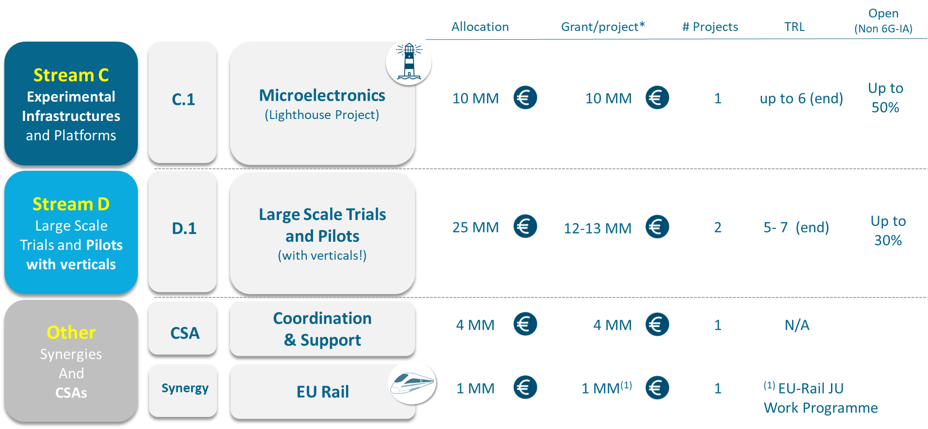
WP 2024 / Streams C, D and Other
*Indicative; this does not preclude submission and selection of a proposal requesting different amounts.

Slide 7
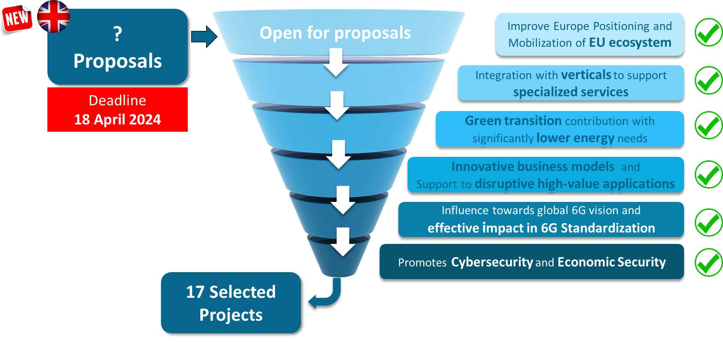
Key orientations for Work Programme 2024

Slide 8
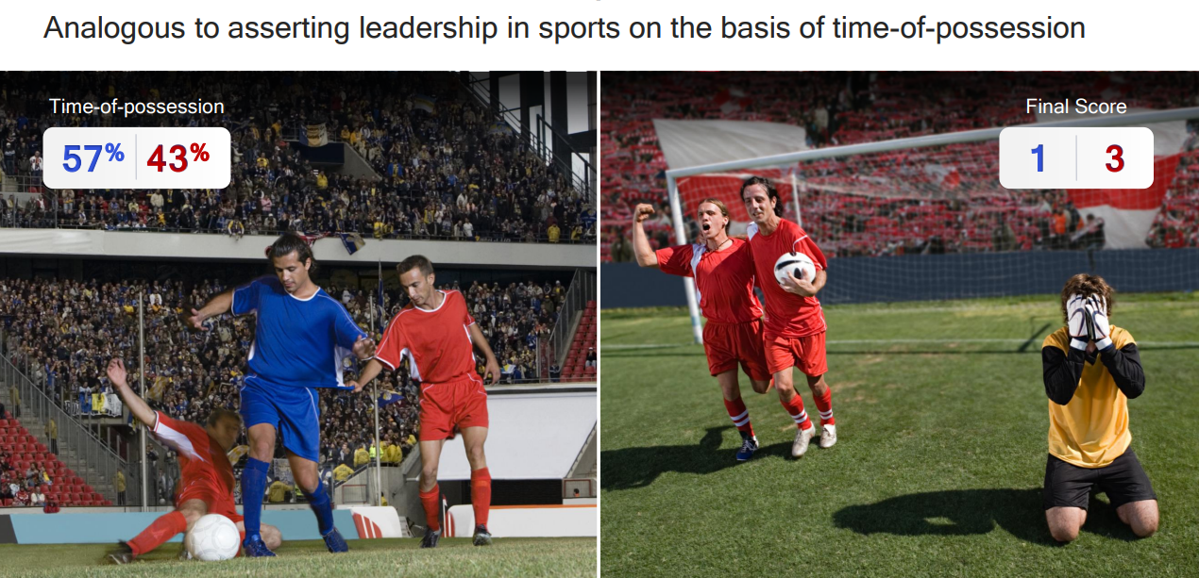
How should we measure success ?
Demystifying 3GPP / September 2018
Notes:
Effective policies should be flexible, adaptive, and responsive to the dynamic nature of technological advancements

Slide 9
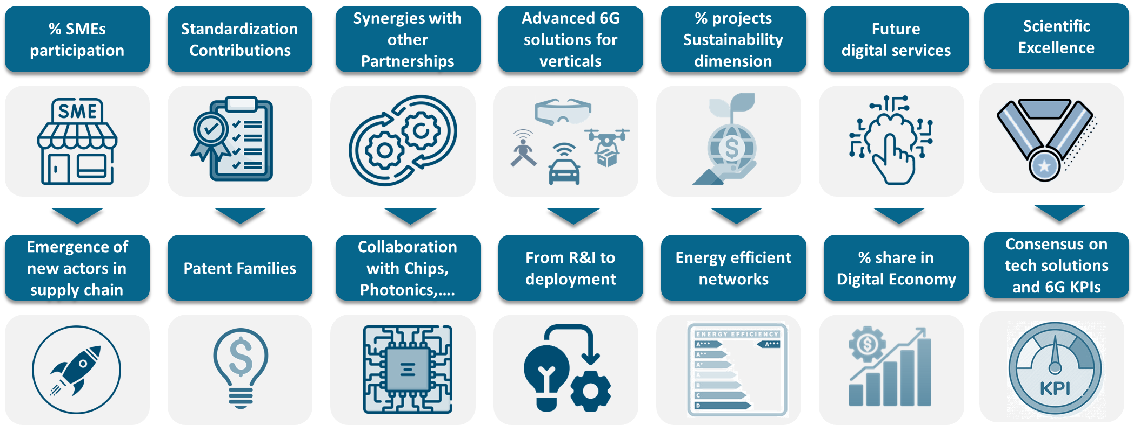
Indicative list of SNS JU KPIs
Non-exhaustive

Slide 10
Contact us:

Slide 11
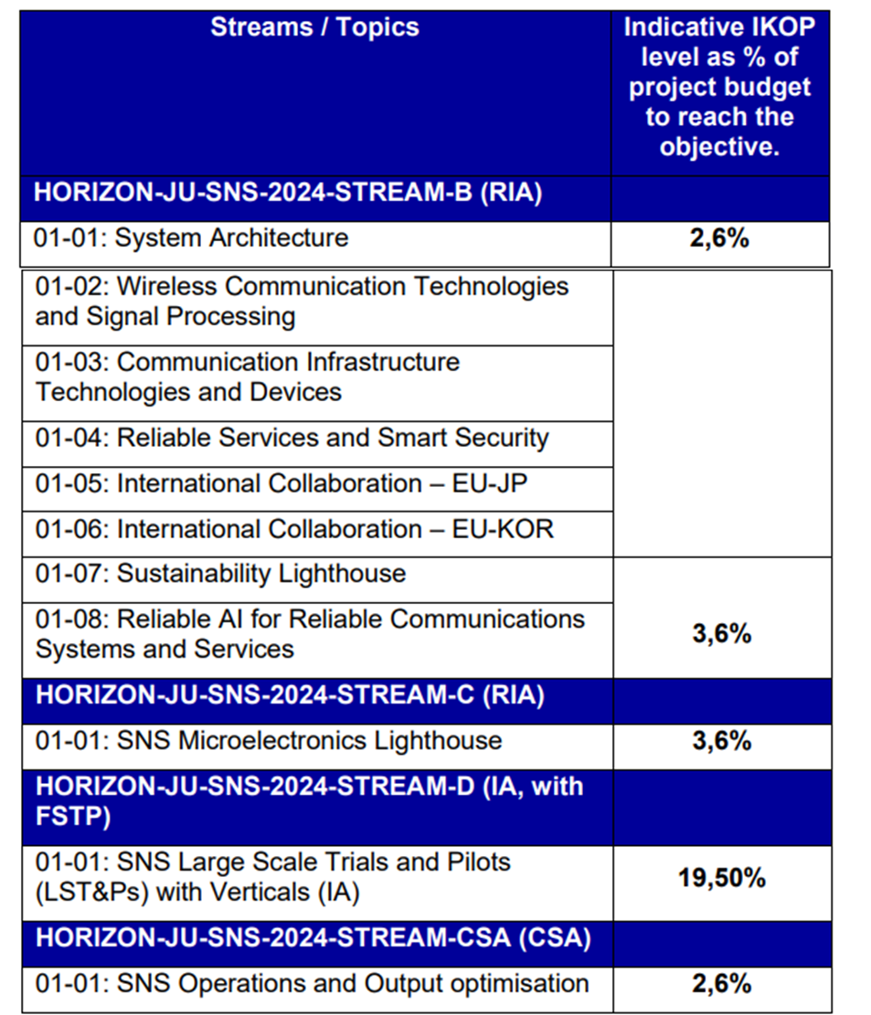
In Kind Contribution to Operational Activities (IKOP)
In-kind contributions to operational activities (IKOP) mean contributions by private members, consisting of the eligible costs incurred by them in implementing indirect actions less the contribution of that JU (and of the participating states of that JU) to those costs.
IKOP target will be an evaluation criterion in all streams and strands.
All SNS streams applicants will be invited to fill a mandatory IKOP declaration table in the Application Form Technical Description
2.6%

